Slide 1

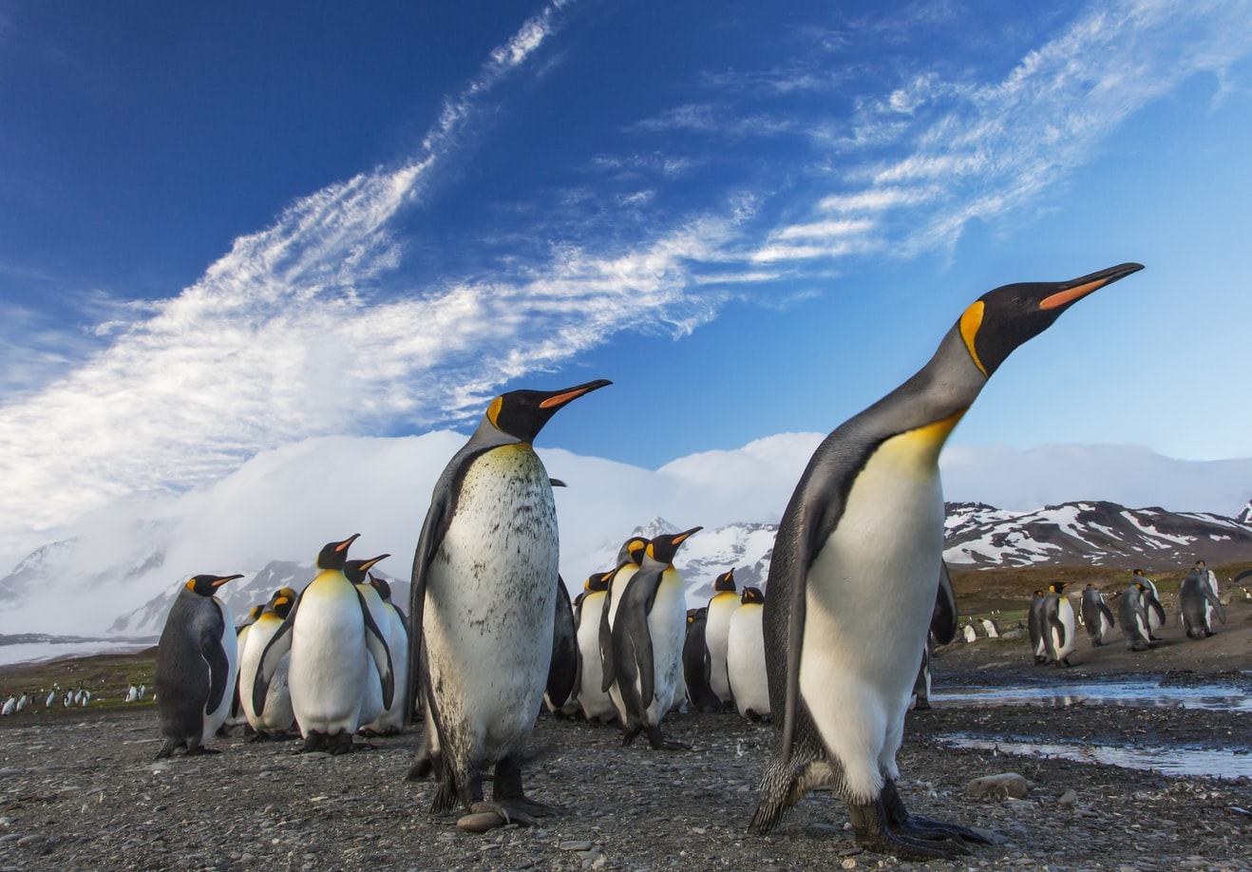

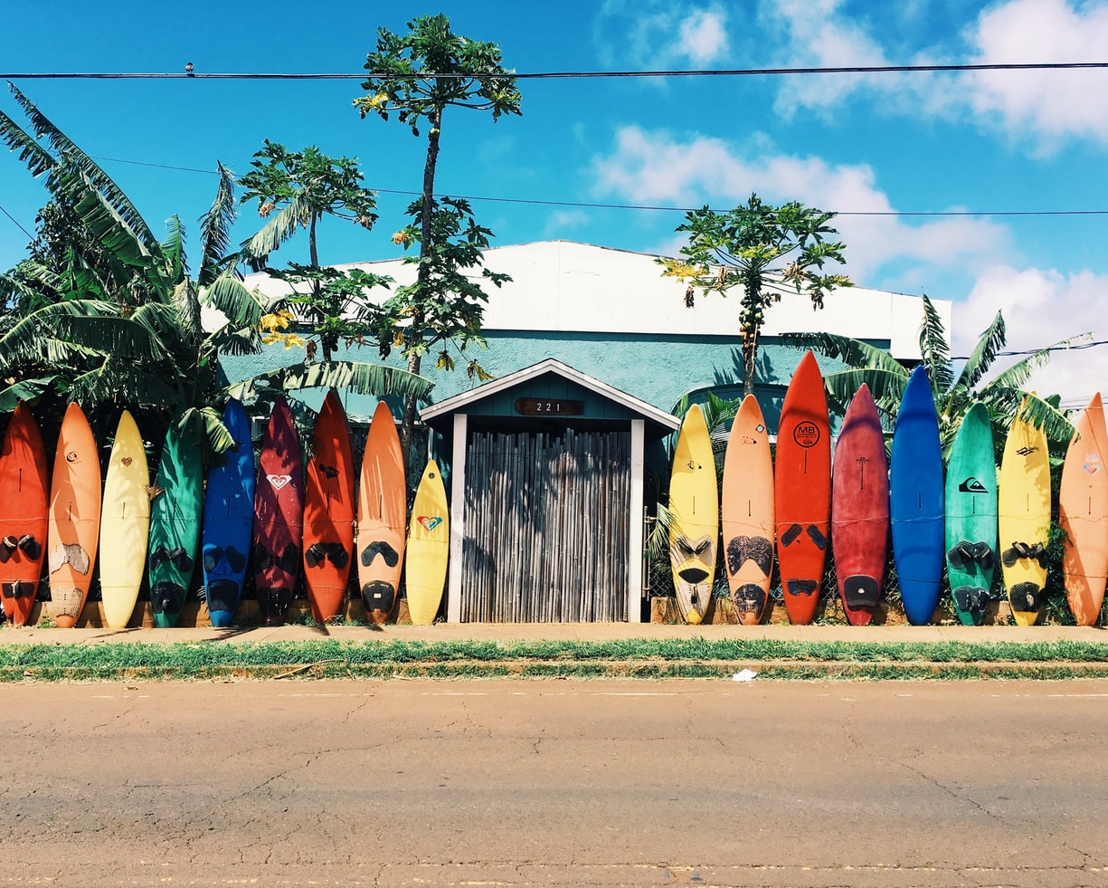
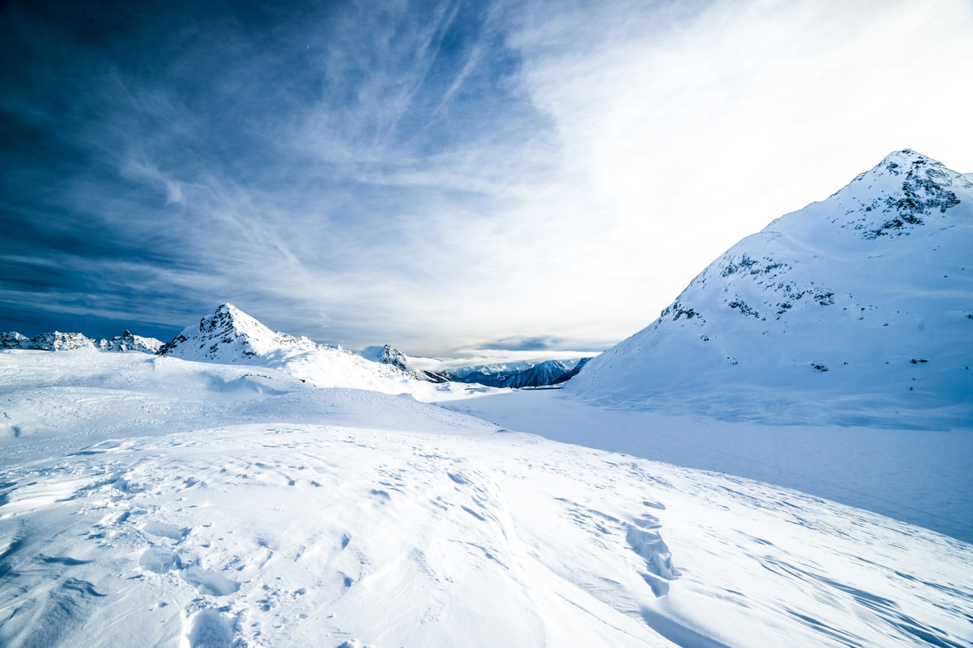

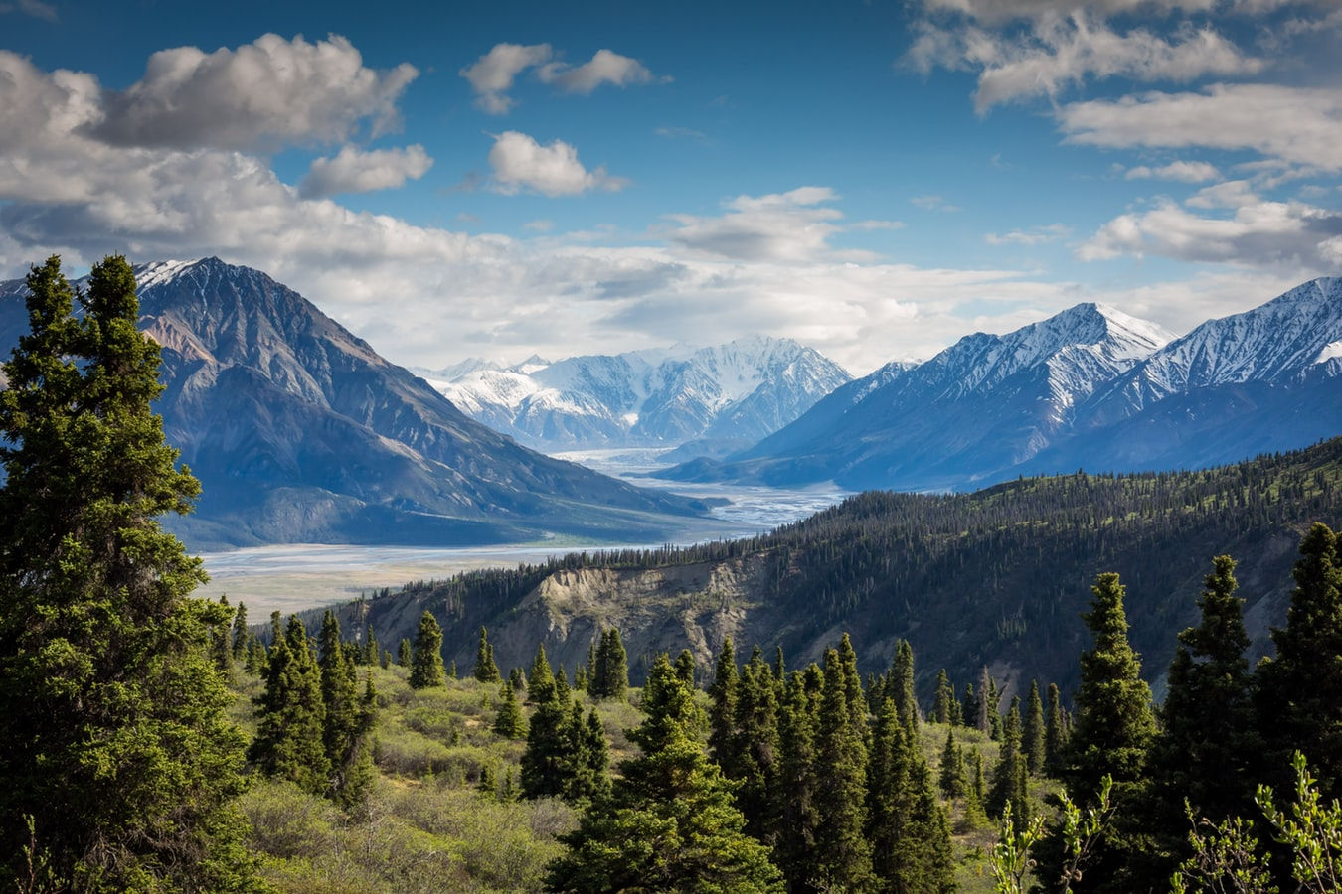

Which picture appeals to you the most? Let us know in chat which # you like the best and why!
1
2
3
4
5
6
7
8
Notes:
Facilitator’s Note: As participants enter the classroom, welcome them and invite them to participate in the opening activity.
Producer’s Note: Assist participants with tools if they are having trouble.

